Slide 1

Friends of Finmere School
Association (FoFSA)
Annual General Meeting
Thursday 3rd November 2022

Slide 2
Chair’s Report 2021/22
Thanked all participants so much for attending this evening, however only a few attendees
Attendees were the xmas committee plus Mrs Law
Appreciate everyone taking time to listen in to what we’ve achieved as FoFSA to support our school during the last academic year and how to can help the school moving forward
Also thanked all the bakers as bit part of the wider team
Some of this year's event have included:
  Fright Night – good turn out
  Autumn and Spring Disco – quick win
  Easter Trail
  Tuck Shop and Cakeaway
  Christmas Market – more of a community feel and a money making event
  Movie Night
  Mothers Day
  Fathers Day

Slide 3
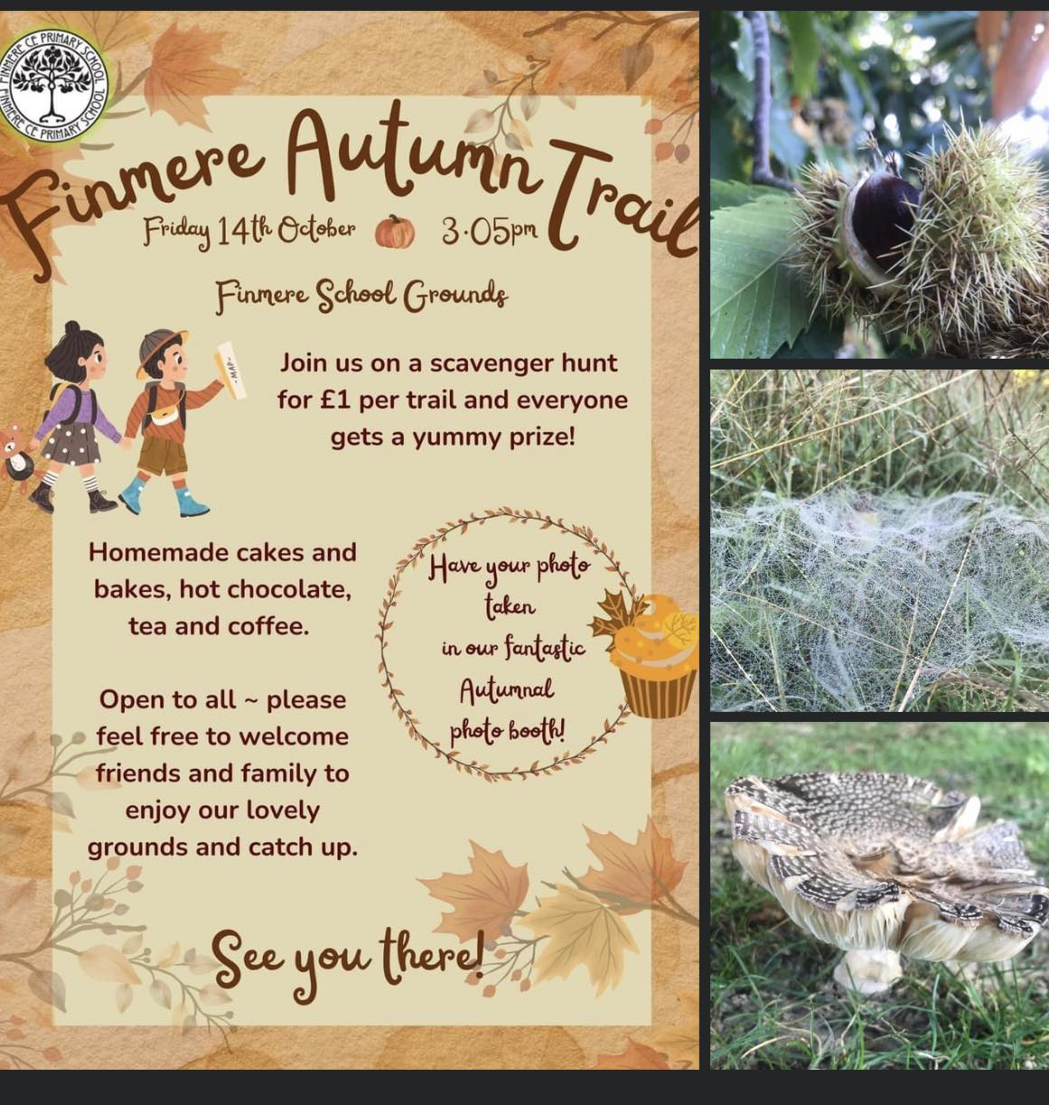
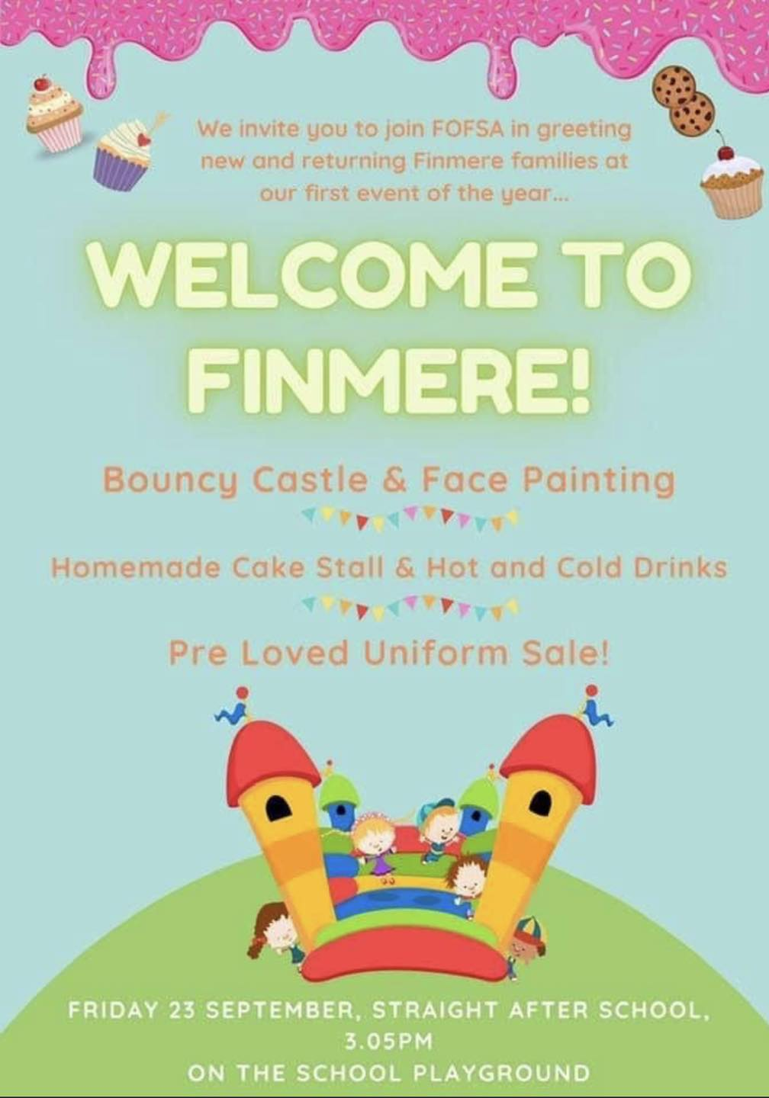
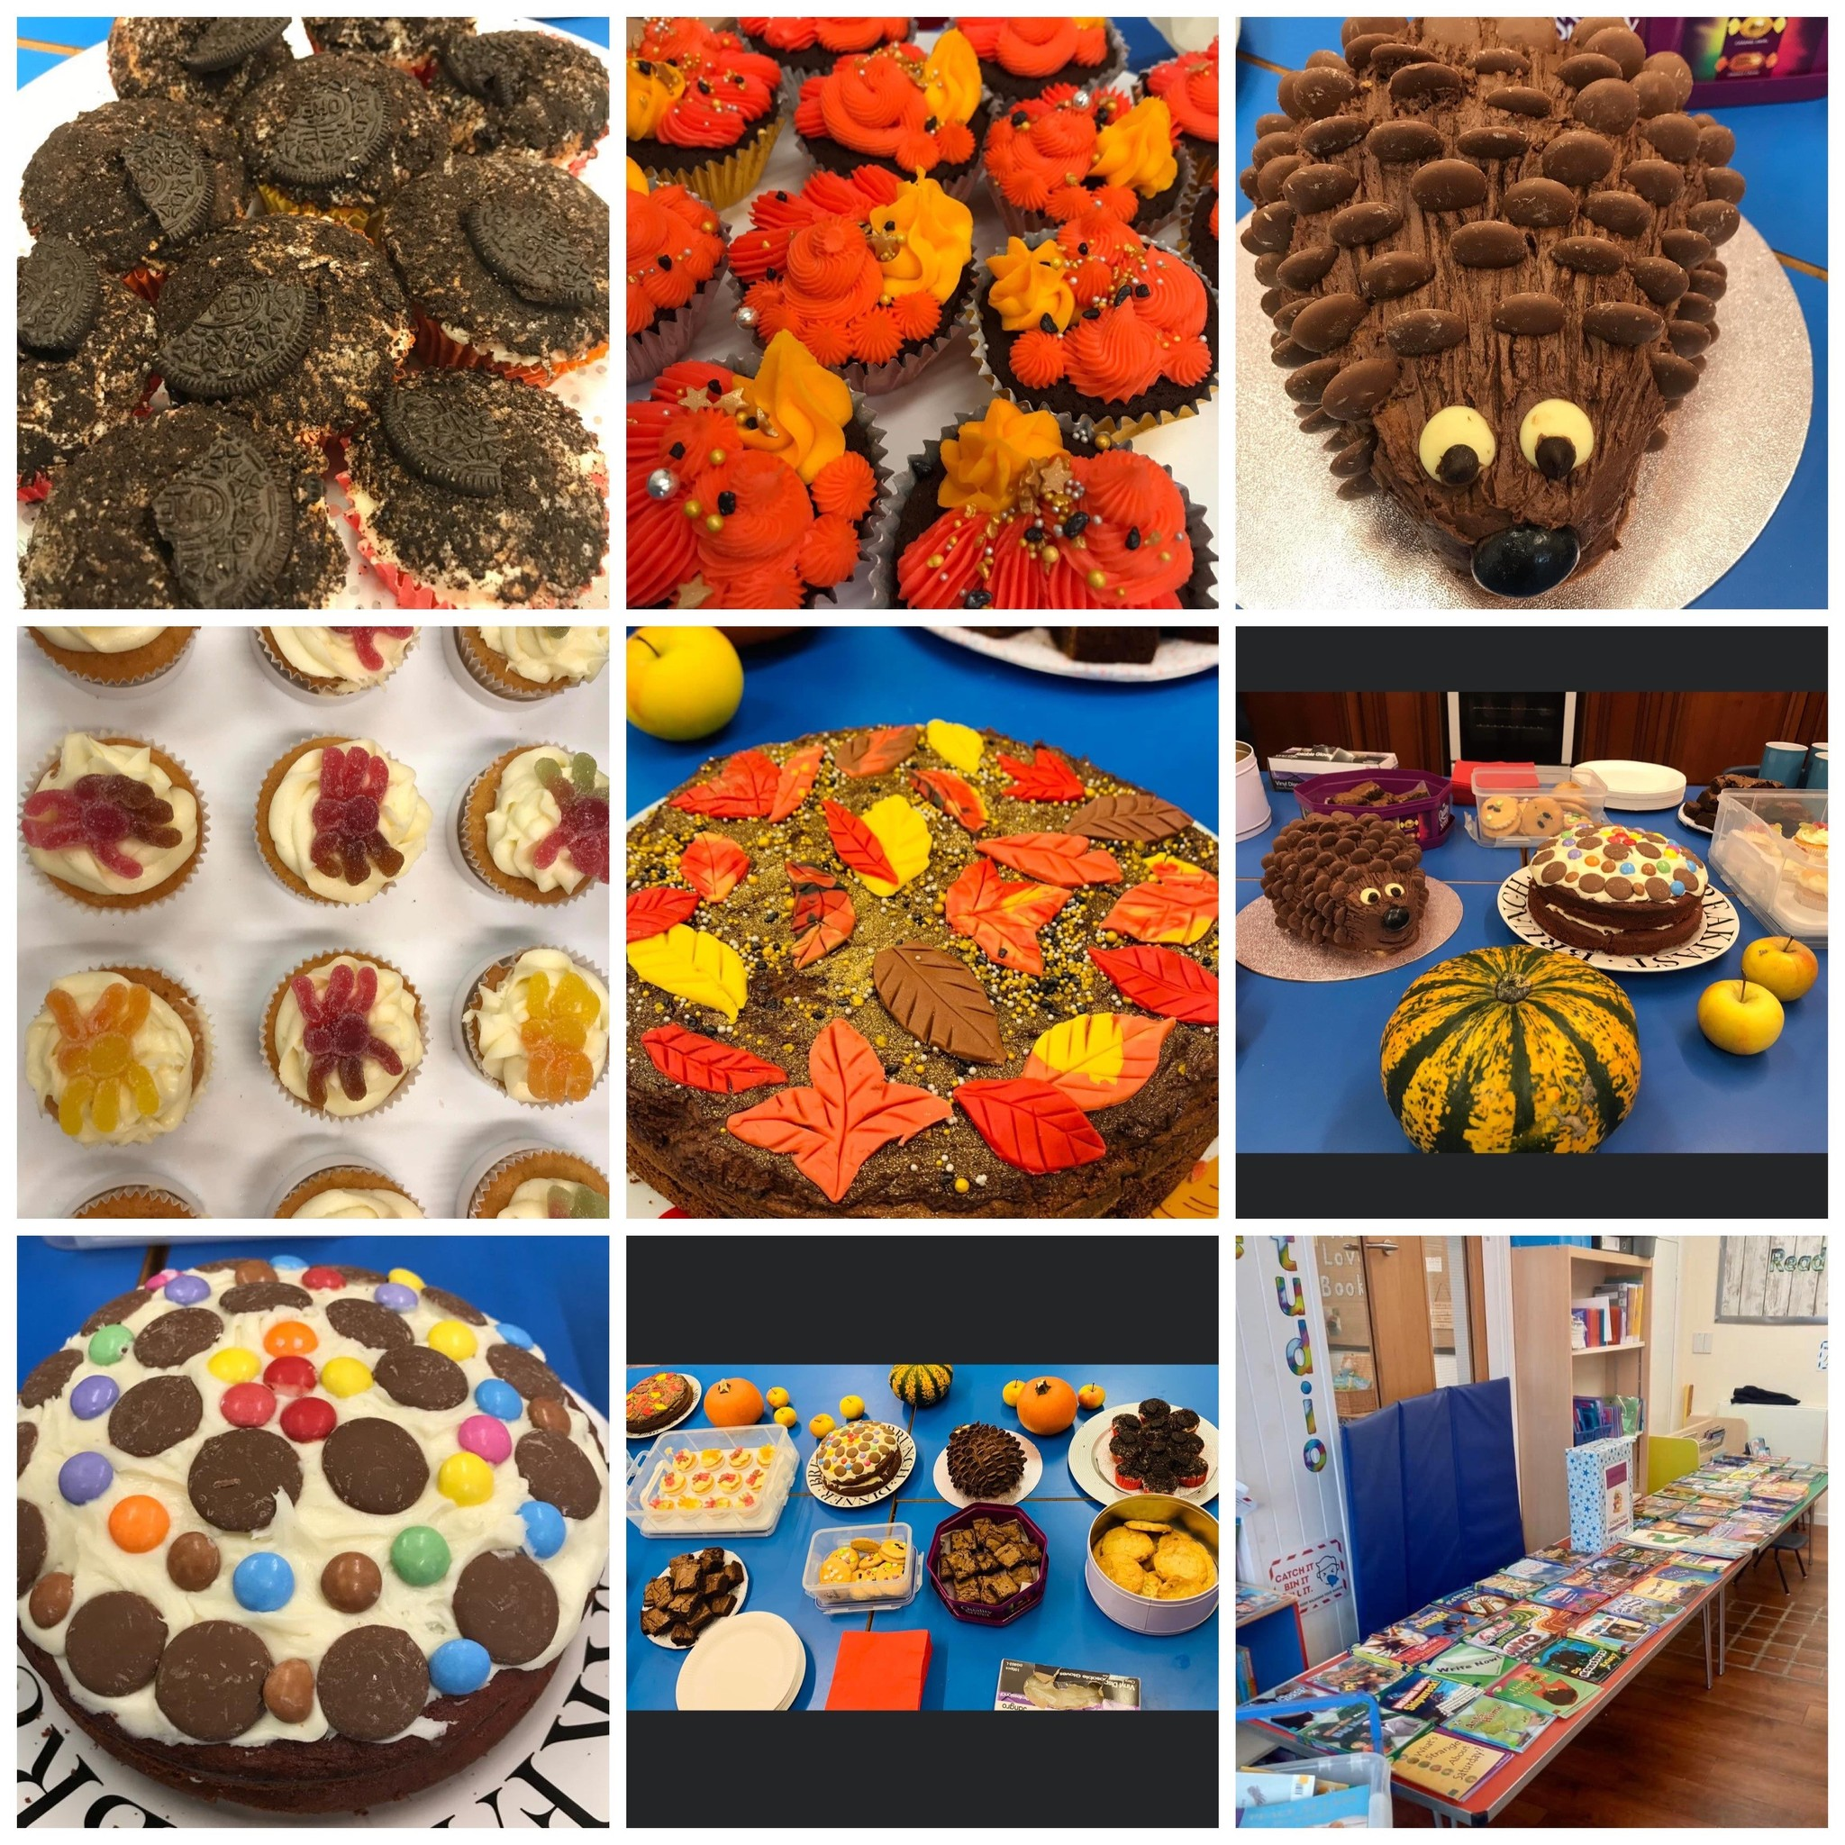

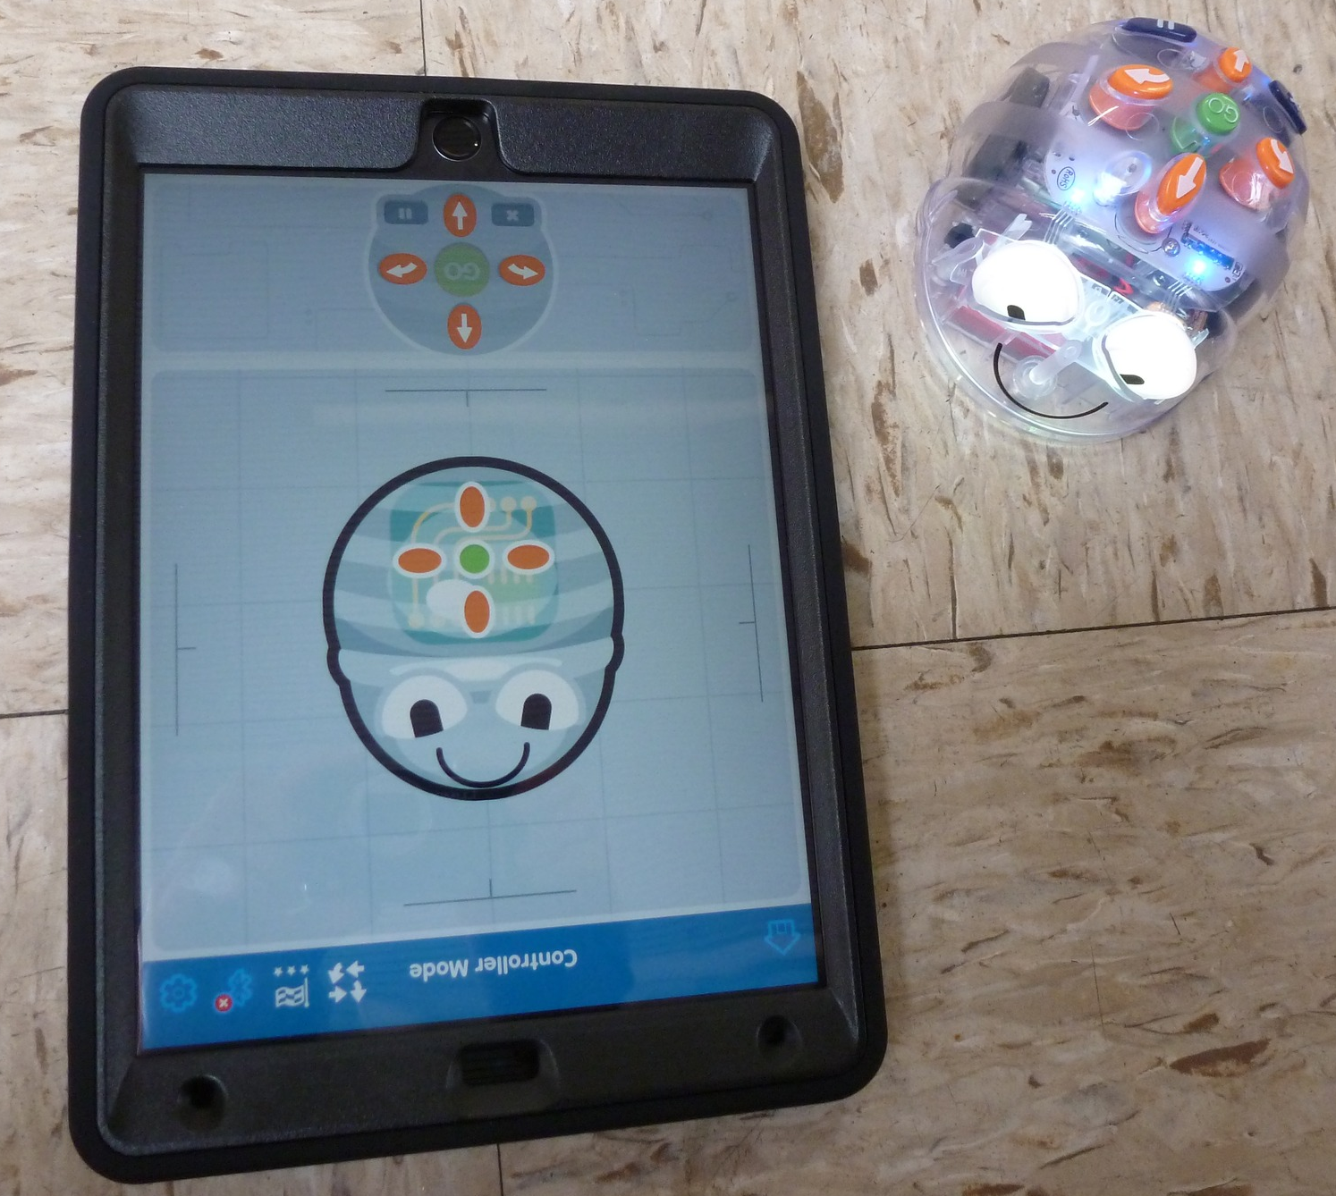
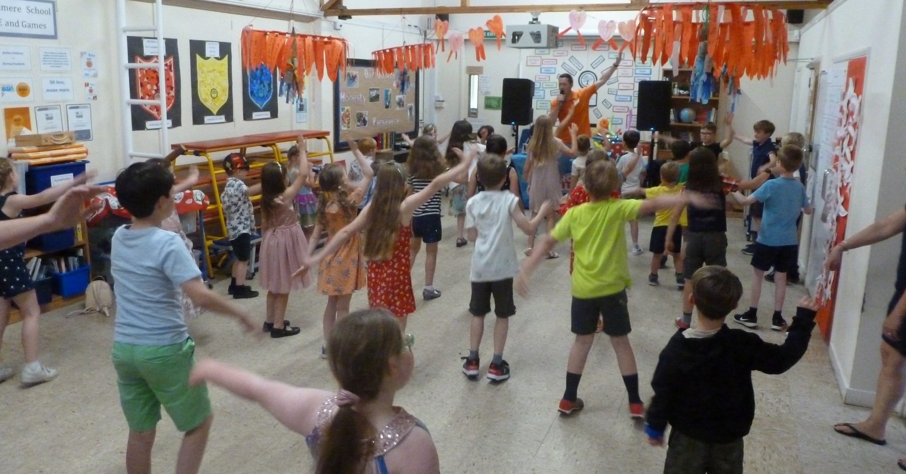

Chair’s Report 2021/22

Slide 4
Chair’s Report 2021/22
FoFSA exists for:
To raise money to provide additional resources to the children and users of the school.
To run events that give great experiences to the children, family, parents & friends of the school.
Be seen as a committee with a wider working group of parents, teachers and friends of Finmere. All committee members welcome suggestions and feedback from all, as all working towards the same end goal. So please speak up ☺
Try to welcome feedback from all parents for ideas, can be on the quiet, doesn’t have to be part of the committee, all ideas are always welcome and extra support where needed
Mrs Law happy to add some text to the newsletter about wanting more ideas and support.
Previous years have done profiles of each committee member, make it more personal
Parents can contact the new FoFSA gmail email
Current Committee: - Everyone happy to keep existing roles
Chair – Sophie Edwards
Vice Chair – Vacancy
Treasurer – Sharon Moore
Vice Treasurer– Nathan French & Chris Garlick
Secretary – Nicol Hick
Vice Secretary – Vacancy
A big thank you to Alicia French and Claire Back for their support to the new FoFSA Committee, especially connected to the Xmas event

Slide 5
Chair’s Report 2021/22
Therefore, we have two positions available this year: - no additional people in the meeting so couldn’t fulfil the below
Vice Chair - helps to ensure that the Committee and all of our events continue to run smoothly. A support in case the Chair unable to attend and to spread the load during a normal busy year of events.
Vice Secretary - helps to ensure that the Committee and all of our events continue to run smoothly. A support in case the Secretary unable to attend and to spread the load during a normal busy year of events.

Slide 6
Treasurer’s Report 2021/22
Sharon Moore pleased to report that for the financial year 2021-2022, FOFSA made a net profit of £1,569.65 and ended the year with a balance of £5,838.58. This puts us in a great position to continue to invest and improve in our lovely little school!
FoFSA ran nine fundraising activities during the year – all were successful in turning a profit. The most profitable fundraisers for the year was the Finmere Fright Night which raised a profit of £1,870.08 and the Christmas Market (profit £1,239.17). We were also fortunate to receive £3,514.62 in donations during the year.
FoFSA main goal for the year was to raise enough money to fund 15 new iPads for the school and pleased to report the iPads (along with protective cases and a storage trolley) were purchased earlier in the year and the children are already enjoying using them. The iPads were the largest expense for the year (£3,758.00), followed by the residential coach costs (£1,090.00) and the Christmas Market (£1,025.68).
Moving forwards…
This financial year won’t see any profits from the Finmere Fright Night so we need to consider how we can substitute these funds from other fundraising activities. It is also worth mentioning that although the Christmas Market brought in a profit, expenditure for the event was excessive and a number of savings could be made to maximise profit.
Spring fete would be the next big event in May 2023

Slide 7
Treasurer’s Report 2021/22
Opening Balance £4,168.93
Total Income £10,345.23
Total Expenditure £8,784.58
Closing Balance on 30/09/21 £5,738.58
Cash Floats £100.00
TOTAL MONIES AVAILABLE £5,838.58
2021-2022 PROFIT £1,569.65

Slide 8
Fundraising ideas in the year ahead
Family bingo
Family games event
Quiz with food and drink in the village hall (evening adults event)
More discos
Race nights
Kids events to be directly after school to help with attendance

Slide 9
Mrs Law’s wish list – looking at different classes
Item | Description | Number needed | Cost | Total cost | Link
Times tables rock stars | Annual cost | 1 | £120.20 | £120.20 | https://ttrockstars.com/page/purchase
Numberbots | Annual cost ( discount if have rockstars) | 1 | £91.25 | £91.25 | https://numbots.com/purchase/
Ocarinas | A set of … | 1 | £97.88 | £97.88 | https://www.tts-group.co.uk/ocarina-musical-instrument/1001908.html
Tooti flutes | For 1 initially as Y5&6 haven't done ocarinas but ultimately a set would be needed | 1 | £25.95 | £25.95 | https://www.musik-produktiv.com/gb/nuvo-toot-2-0-wbl.html
Free standing whiteboards | For phonics teaching | 2 | £84.95 | £169.90 | https://www.amazon.co.uk/Mobile-Rolling-Whiteboard-Aluminum-Standing/dp/B07XL2ZH57/ref=sr_1_4_sspa?crid=1S0RQ940975QW&keywords=free+standing+whiteboard&qid=1666721987&qu=eyJxc2MiOiI1LjQxIiwicXNhIjoiNS4wNiIsInFzcCI6IjQuNjkifQ%3D%3D&sprefix=free+standing+whiteboard%2Caps%2C67&sr=8-4-spons&psc=1
Pocket chart | For phonics teaching | 2 | £15.95 | £31.90 | https://www.amazon.co.uk/gp/product/B07S7BQ5F8/ref=ewc_pr_img_2?smid=A12GHPXXDCO5C8&psc=1
Magnetic whiteboards | At least 10 | 10 | £10.99 | £109.90 | https://www.amazon.co.uk/SwanSea-Magnetic-Whiteboard-Double-Planning/dp/B01J4YY918/ref=sr_1_5?crid=3BZQ7HO4AYTPN&keywords=kids+magnetic+whiteboards&qid=1666722159&sprefix=kids+magnetic+whiteboards%2Caps%2C74&sr=8-5
Waterwall | For Early Years | 1 | £100.72 | £100.72 | https://www.amazon.co.uk/Playhouse-Waterwall-Educational-Childrens-Coordination/dp/B09QMD7DL9/ref=sr_1_23?crid=22554JTUSK2IU&keywords=water+tray+toys+for+early+years&qid=1666722262&qu=eyJxc2MiOiI1LjIwIiwicXNhIjoiNC45MyIsInFzcCI6IjQuMDYifQ%3D%3D&sprefix=water+tray%2Caps%2C85&sr=8-23

Slide 10
Mrs Law’s wish list – looking at different classes
Magnetic tiles |  | 1 | £29.99 | £29.99 | https://www.amazon.co.uk/Magnetic-Building-Learning-Educational-Construction/dp/B095HFS97F/ref=sr_1_30?crid=22554JTUSK2IU&keywords=water+tray+toys+for+early+years&qid=1666722339&qu=eyJxc2MiOiI1LjIwIiwicXNhIjoiNC45MyIsInFzcCI6IjQuMDYifQ%3D%3D&sprefix=water+tray%2Caps%2C85&sr=8-30
Water tray | To replace broken one | 1 | £318.77 | £318.77 | https://www.amazon.co.uk/Clear-Water-Tray-Blue-Stand/dp/B01N3Q3BQ8/ref=sr_1_1_sspa?crid=1A2Z4JGE7YG4R&keywords=water+tray&qid=1666722466&qu=eyJxc2MiOiI2LjE0IiwicXNhIjoiNS43MSIsInFzcCI6IjUuMTYifQ%3D%3D&sprefix=water+tray%2Caps%2C91&sr=8-1-spons&psc=1
Chalk houses |  | 1 | £29.99 | £29.99 | https://www.etsy.com/uk/listing/762303287/early-years-blackboard-wooden-houses?ga_order=most_relevant&ga_search_type=all&ga_view_type=gallery&ga_search_query=chalkboard+wood+house&ref=sr_gallery-1-4
Gruffalo puppets |  | 1 | £31.99 | £31.99 | https://gruffaloshop.com/collections/the-gruffalo-soft-toys/products/gruffalos-child-finger-puppets?variant=9154533883969
Letters upper case |  | 1 | £39.96 | £39.96 | https://www.babipur.co.uk/toys/wooden-toys-sale/plan-toys-lower-case-alphabet.html
Letters lower case |  | 1 | £39.96 | £39.96 | https://www.babipur.co.uk/toys/wooden-toys-sale/plan-toys-lower-case-alphabet.html
RWI letter tiles for teaching phonics |  | 7 | £4.90 | £34.30 | https://www.amazon.co.uk/Magnetic-Phonics-Letters-Sounds-Words/dp/B01MFB4KY1/ref=sr_1_4?keywords=rwi+magnetic+letter&qid=1666723052&qu=eyJxc2MiOiIwLjAwIiwicXNhIjoiMC4wMCIsInFzcCI6IjAuMDAifQ%3D%3D&sprefix=magnetic+letter+rwi%2Caps%2C96&sr=8-4

Slide 11
Mrs Law’s wish list – looking at different classes
Clipboard | 2 packs of 5 | 2 | £8.85 | £17.70 | https://www.amazon.co.uk/Clipbboard-Translucent-Rubberized-Assorted-TKD8050-A6-5X/dp/B08CF3NX8Y/ref=sr_1_3_sspa?keywords=mini+clipboard&qid=1666723190&qu=eyJxc2MiOiI1LjMyIiwicXNhIjoiNC43NiIsInFzcCI6IjQuNDQifQ%3D%3D&sprefix=mini+cli%2Caps%2C94&sr=8-3-spons&psc=1
Digital microscopes | Or more -link is a suggestion | 10 | £39.99 | £399.90 | https://amzn.eu/d/bOG11iu
Maths mastery resources | 1 set or more? | 1 | £198.99 | £198.99 | https://www.earlyyearsresources.co.uk/eyfs-maths-c1931/maths-classroom-resources-c1939/natural-maths-mastery-collection-p92273
Giant numicon for outside |  | 1 | £166.99 | £166.99 | https://www.earlyyearsresources.co.uk/outdoor-learning-c149/outdoor-curriculum-c370/numicon-large-foam-shapes-p30640
Maths resources | 1 set or more? | 1 | £163.99 | £163.99 | https://www.earlyyearsresources.co.uk/eyfs-maths-c1931/numicon-c1938/numicon-firm-foundations-one-to-one-apparatus-pack-p94351
More laptops with keyboard and chargers | Approx cost? needs investigating …. | 20 | £400.00 | £8,000.00 | https://www.currys.co.uk/products/hp-pavilion-14dv2500sa-14-laptop-intel-core-i3-256-gb-ssd-silver-10238825.html
iPads | Approx cost how many? |  | £400.00 | £0.00 | https://www.apple.com/uk/shop/buy-ipad
K-Nex | Class set | 1 | £26.99 | £26.99 | https://amzn.eu/d/3j516px
Set of Atlas KS2 | Suggested atlas ? | 10 | £11.05 | £110.50 | https://amzn.eu/d/75sbXur
Cookery aprons | 10 little 10 medium 10 big ones | 30 | £5.20 | £156.00 | https://noyna.com/?gclid=EAIaIQobChMIpaXx1bmt_AIVA9DtCh123wz1EAAYASAAEgIRe_D_BwE
Science set of electrical circuit Equipment | a class set of electrical circuit equipment with batteries, a very good set of torches and batteries, stop watches, |  |  | £0.00

Slide 12
Mrs Law’s wish list – looking at different classes
Science set of electrical circuit Equipment | a class set of electrical circuit equipment with batteries, a very good set of torches and batteries, stop watches, | £0.00
Redecorate school |  | £0.00
Proper storage for musical equipment
Gardening materials | – better child friendly diggers/trowels etc and also a regular ‘stipend’ for gardening – for example every autumn money for bulbs, a regular supply of compost and in the spring – plants/vegetables to grow. We should be growing stuff in our grounds! – This could mean organising/buying/paying for someone to put in another raised bed or two for specific gardening activities | £0.00
Sports tops | a selection of sizes (KS2) of sports tops that can be worn for any sporting event by footballers/netballers/athletics/quadkids etc. It would say ‘Finmere Sports’ or similar on the back | £0.00

Slide 13
FUNDRAISING IN THE YEAR AHEAD
Discussions:
Fundraising for the bigger ticket items will generate more money
Laptops – need to be the same throughout to help teaching
Rabbit proof the raised beds and create new raised beds if necessary
Current pond – Willow trees near the pond are now all safe based on tree specialist making the area safe including the cabling. Pond is now all dry up and attracted mosquitos in the summers. Requires a new liner as base is now mud and stagnant water and potentially a pump to avoid the water turning stagnant. Moores Landscapes to assess the pond and see what is doable
Raised bed – vegetables for snacks etc but needs to be manageable

Slide 14
Fundraising in the year ahead
Online Fundraising – all still exist but need to publicise to remind people
Relaunch of Easy Fundraising and Amazon Smile (charity number 1042651)
Paypal account for FOFSA – actioned
School lottery scheme

Slide 15
Fundraising in the year ahead
Upcoming Events
December 11th – Christmas fete
Incredible amount of raffle prizes
Newsletters to start going out early November
Next meeting 8th November 8pm

Slide 16
AOB?
Xmas committee meeting booked in
Xmas Disco for all ages. Non uniform
3-5pm
Additional books to be given out by Santa
Mrs Law closed by saying she is very appreciative of all the hard work that everyone is doing to raise money for the school

